Slide 1
Lecture 16
Economic Growth, Information and Cities
16.2 The link between urbanization and economic growth
IUS 9.2
©Luís M. A. Bettencourt 2024
Notes:
OK. We are leaving the story about the growth rate of the economy and information suspended, and will in this module discuss another famous relationship: between national levels of urbanization and real income per capita.

Slide 2
Recall:
Economic Growth
where do economic growth rates come from?
$$\frac{dY}{dt}=ηY$$
Exponential Growth: 2-3% a year for USA
noisy, scale dependent, variable
inequality
Notes:
Recall …

Slide 3
What creates growth?
$$η$$
structural
individual
urbanization
learning, agency and investment
Notes:
When taken on the aggregate of nations we can also divide the growth rate interns of structural contributions (how people live and connect to each other), and what they know. We know that these two things are connected in cities, but here, motivated by Bob Lucas’ remark we are going to ask what happens as a nation urbanizes and a greater faction of people live in cities, as opposed from rural subsistence. (The existence of cities transforms rural areas in urbanized societies).

Slide 4
Urbanization and Economic Growth

Slide 5
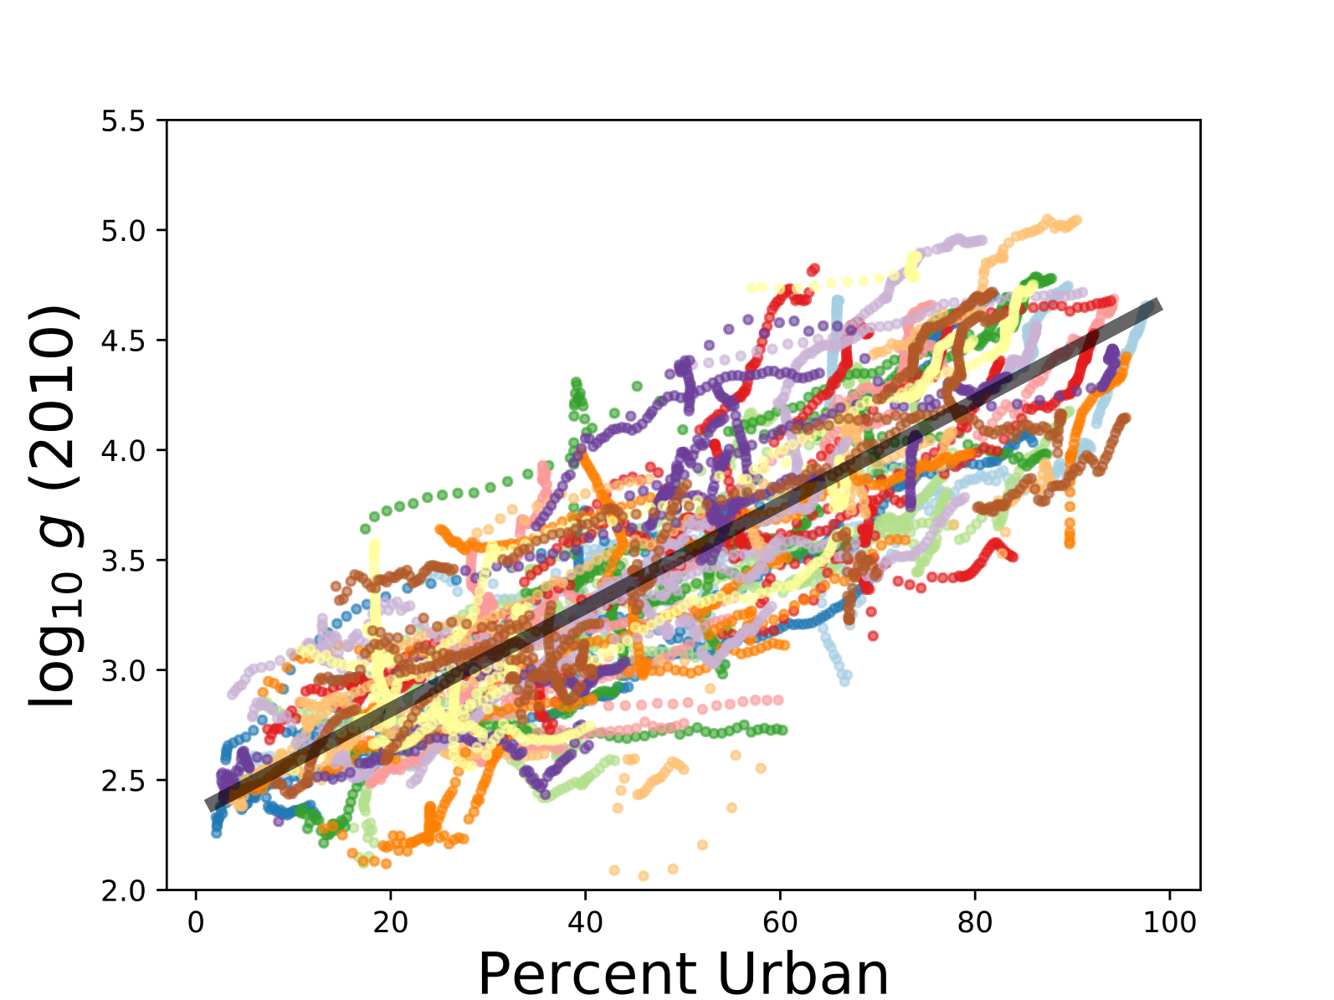
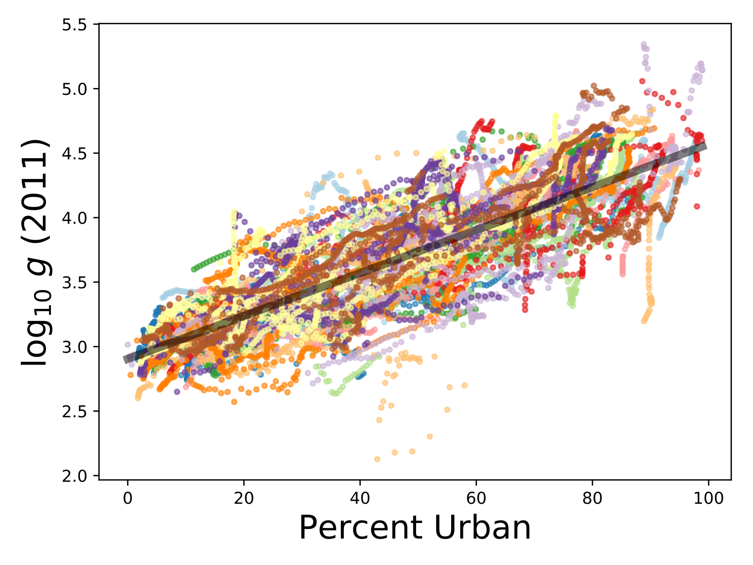
How can we explain this association? What does it tell us about economic growth? and Cities?
https://databank.worldbank.org/source/world-development-indicators
https://ourworldindata.org/grapher/urbanization-vs-gdp
A.
B.
World Bank
Our World in Data
y
y
Liberia
Liberia
Fit:
$$\log_{10}y(u)=\log_{10}y(0)+a_{y}u$$
spectacular !!
$235/year
Growth rate of GDP/capita with urbanization is :
$$a_{y}^{′}=a_{y}ln10≃4-5\%$$
$$a_{y}≃0.02$$
$$y=y_{0}{10}^{a_{y}u}=y_{0}e^{a_{y}ln10u}$$
$$a_{y}^{′}=a_{y}\underset{⏟}{ln10}≃4-5\%$$
The puzzle here is that there is no “time”: this suggests a purely structural transition
$$≃2.3$$
Notes:
Ok, so here is the data. These two plots are essentially the same, the left from the World Bank “world development indicators” database (goes back to 1960 in most nations), and the left from Our World in Data, which adds a few other sources. The result is rough, but on average quite compelling: each 1% of urbanization leads to 4-5% growth in real GDP per capita. Amazing, no? This goes from zero urbanization at $235/ year (extreme poverty) to ~$50K year per capita in modern rich economies. No time, no technology, just urbanization !!

Slide 6
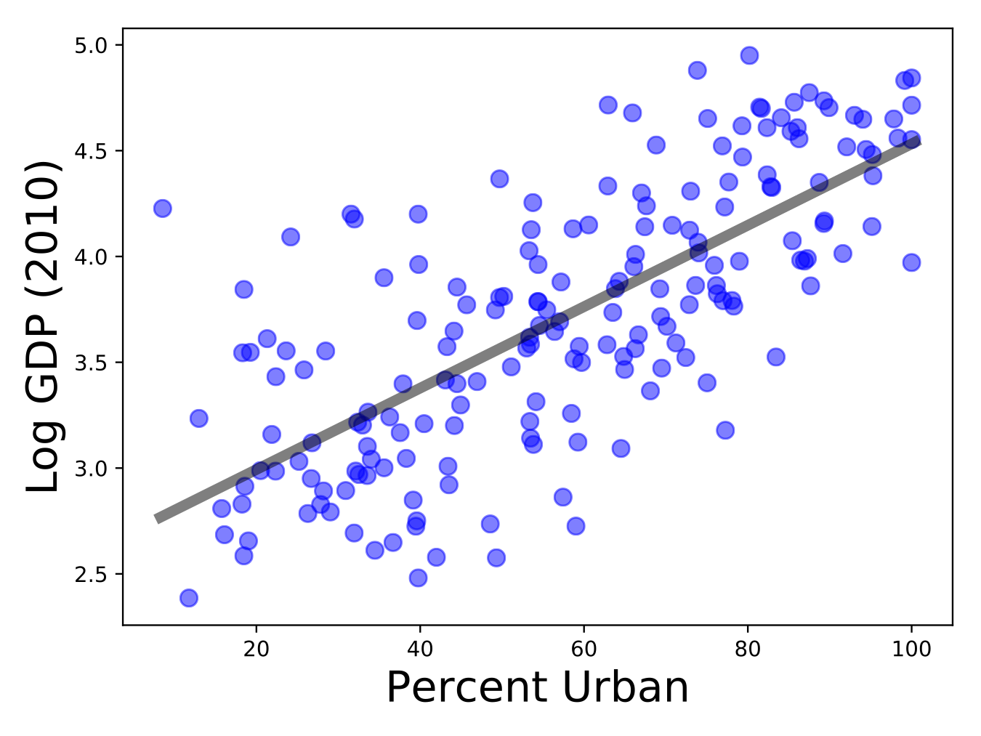
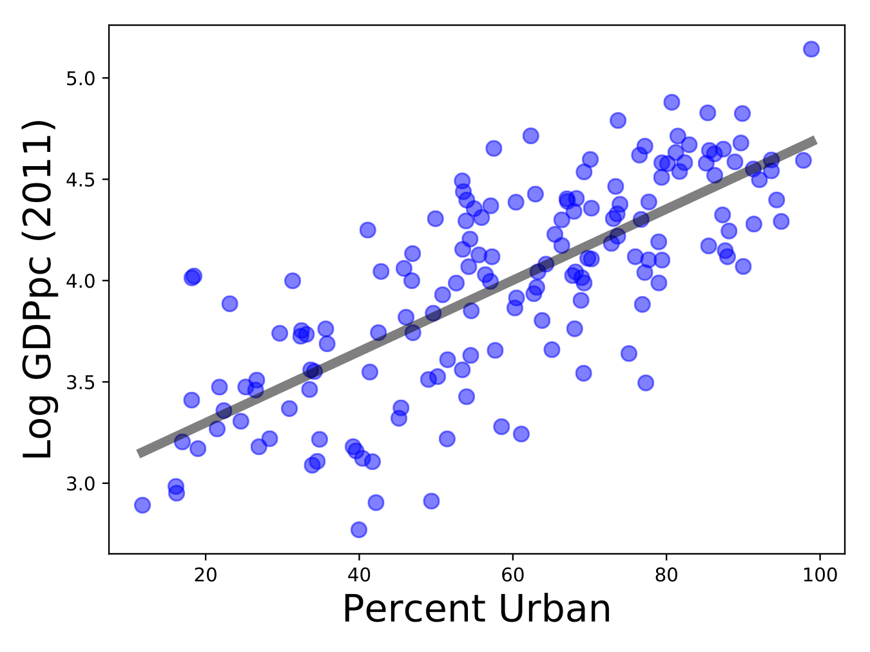


This also holds for each year across nations
https://databank.worldbank.org/source/world-development-indicators
https://ourworldindata.org/grapher/urbanization-vs-gdp
A.
B.
World Bank
Our World in Data
y
y
similar fits to that across nations and time
Notes:
This is observed (roughly) cross sectionally for a given year, as shown here.

Slide 7
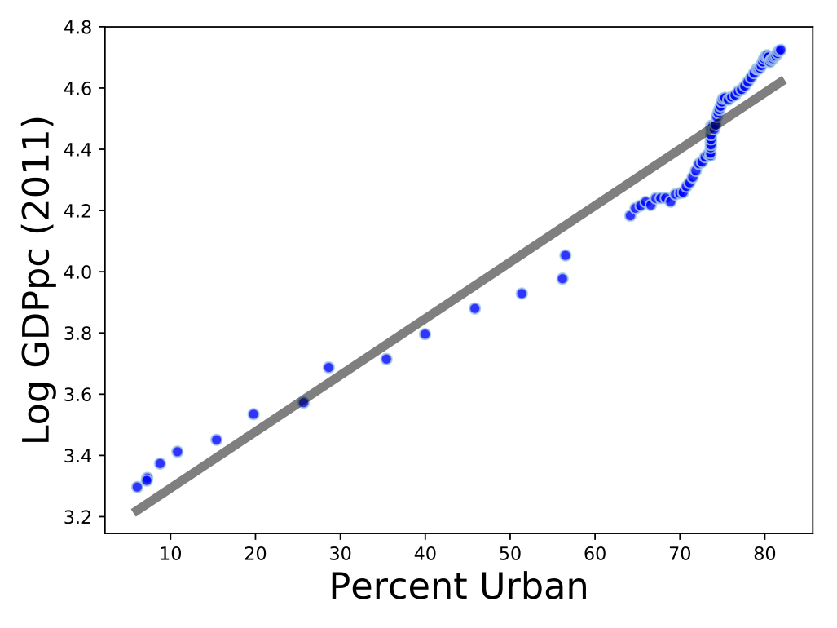
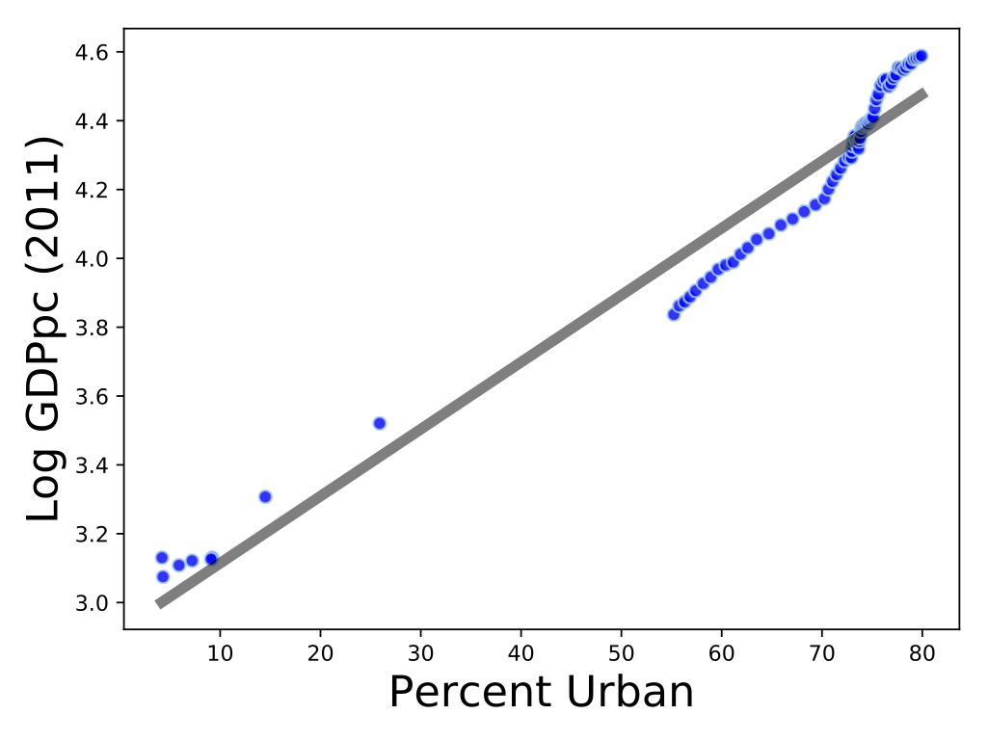
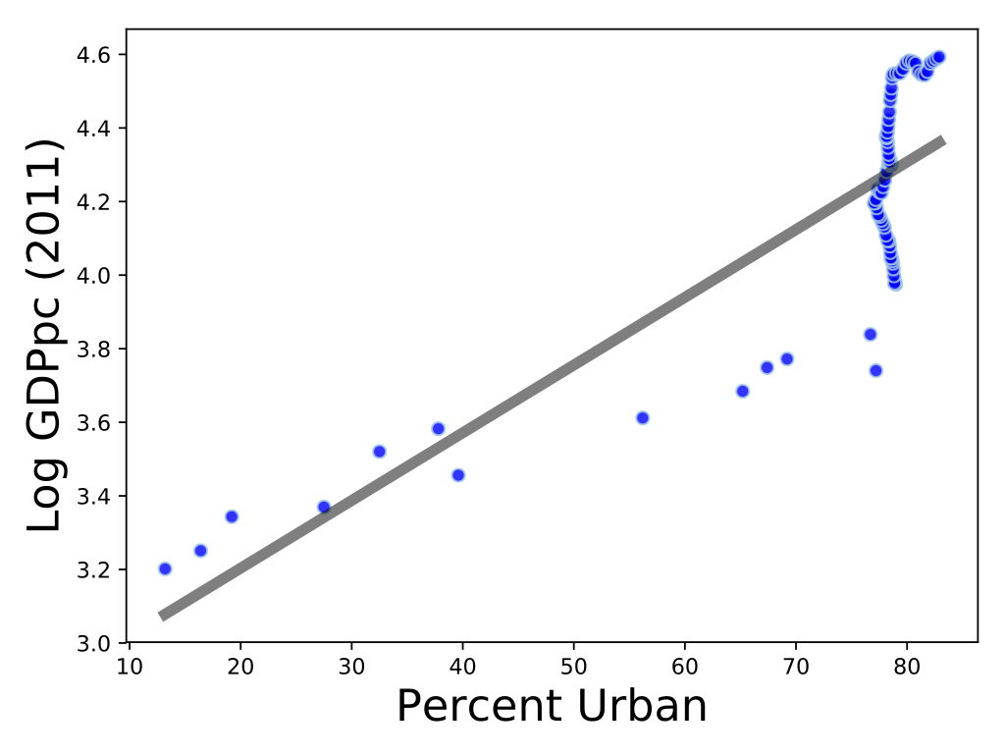
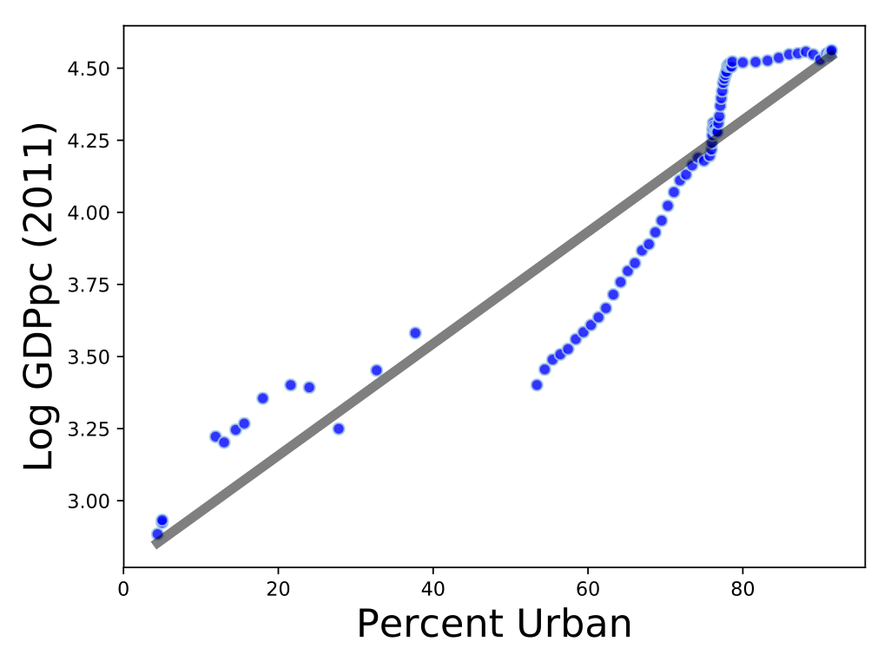
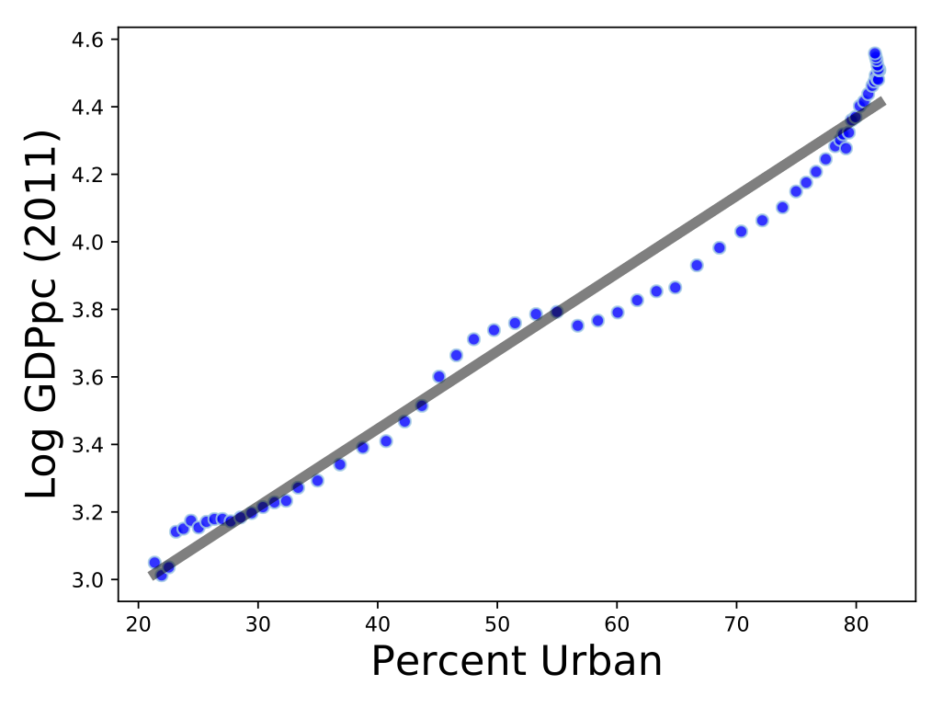
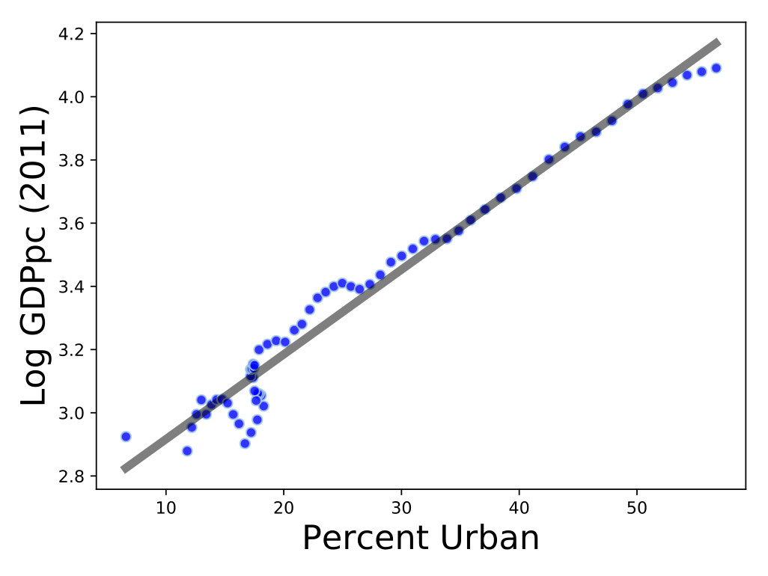
And more roughly over time
in each nation
USA
France
y
y
𝟒.𝟐%
𝟒.𝟐%
Japan
UK
y
y
𝟒.5%
𝟒.4%
South Korea
China
y
y
5.3%
6.2%
Notes:
And, for individual national trajectories over time. Note that some of these are jumpy (UK, Japan) while others quite steady, following the lines more or less. Also note that the rate of growth w urbanization varies a bit. It is even more spectacular for Korea and China than it was say for the US. The UK was the first nation to urbanize, and living conditions were dismal for a while.

Slide 8
How to get rid of time?
$$\log_{10}y=\frac{1}{ln10}∫^{t}dt^{′}\frac{d}{dt^{′}}lny(t^{′})$$
$$lny≃γ_{y}(t-t_{0})$$
define the average growth rate of the GDP per capita, averaged over some time period:
$$γ_{y}=\frac{1}{t-t_{0}}∫_{t_{0}}^{t}dt^{′}\frac{d}{dt^{′}}lny(t^{′})$$
$$lny(t)=\frac{1}{ln10}\log_{10}y=γ_{y}(t-t_{0})$$
The log of GDP/capita is the average growth rate times time.
need to express both $γ_{y}$ and $t-t_{0}$ as functions of urbanization rate, $u$
Notes:
OK, how do we build a bit of theory to explain these findings? First, we need to get rid of time and exchange it for the urbanization rate. The key is to recognize that the log income is the integral of the growth rate, i.e. the average growth rate times the time period. This is one of the reasons why its a reasonably stable variable, it is an integral of a stochastic quantity (obeying a central limit theorem).

Slide 9
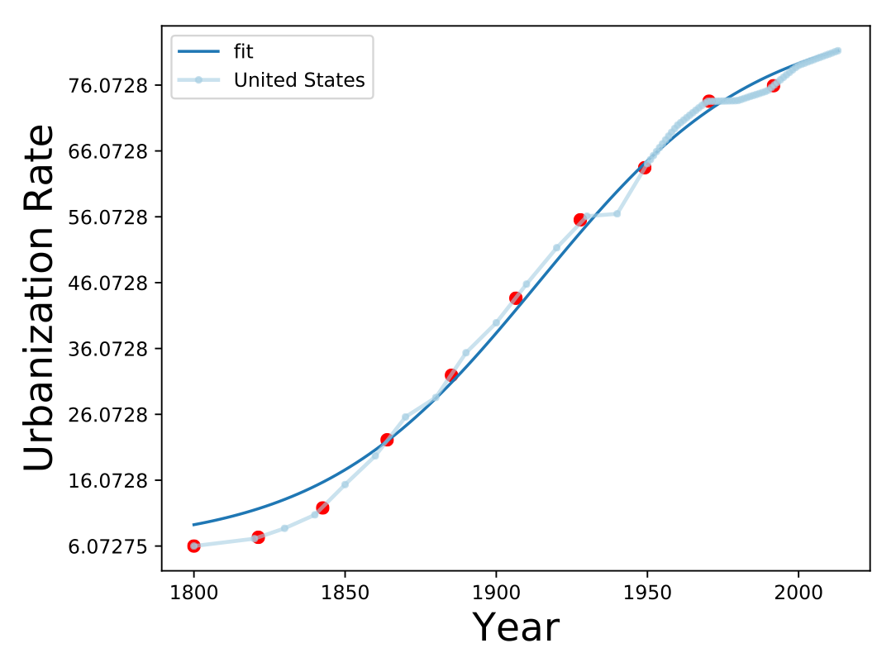
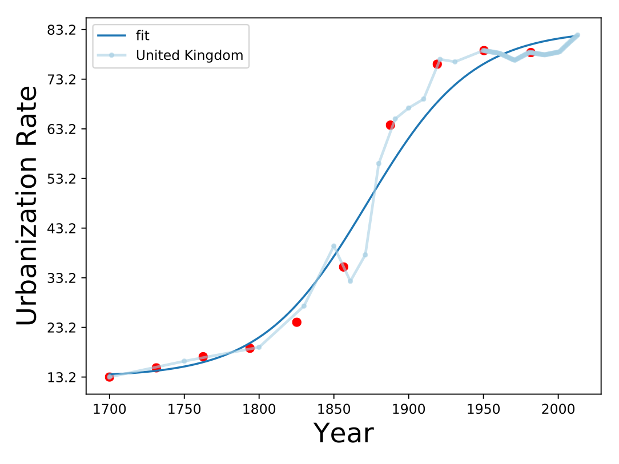
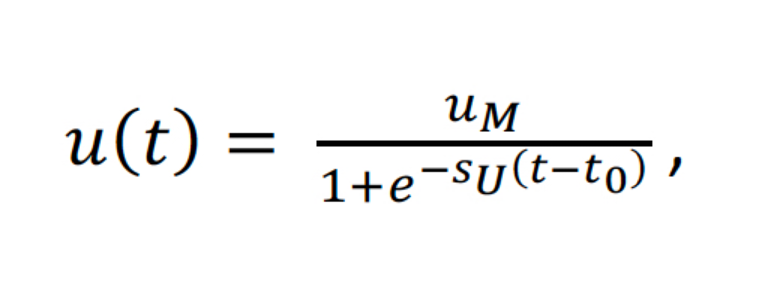
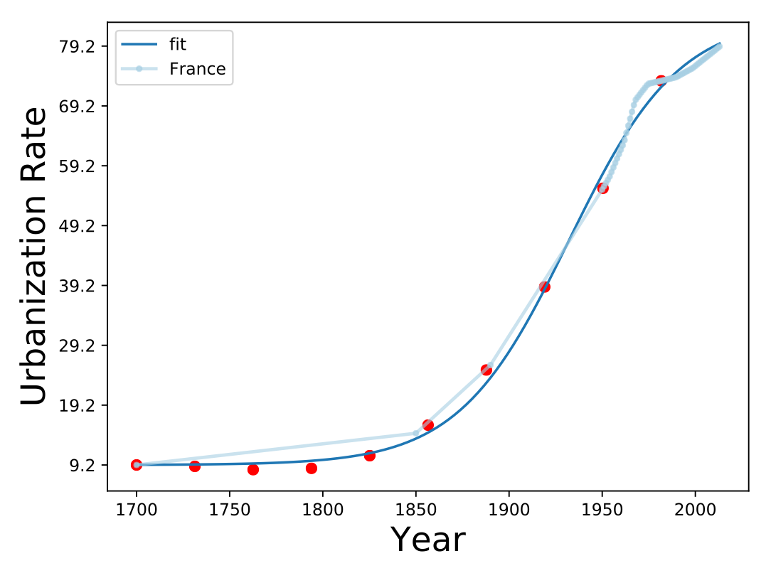
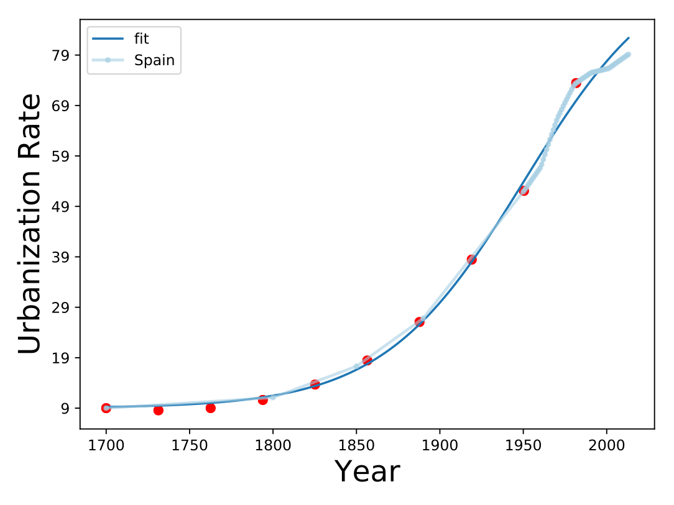
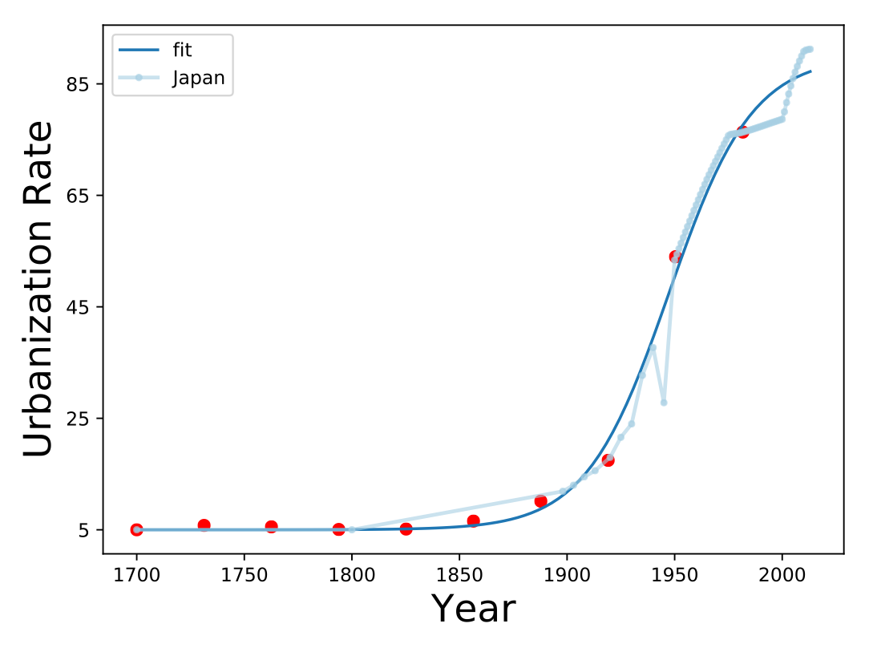
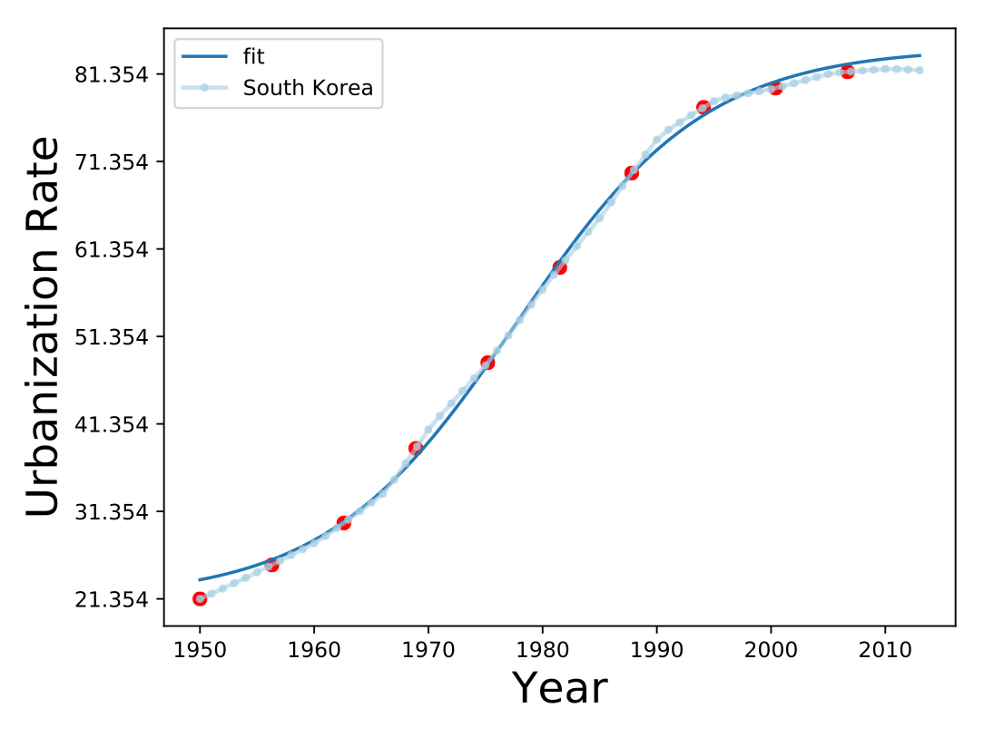
Nations urbanize
in the same way but
at very different speeds
US
$$s_{u}^{-1}$$
$$k^{-1}=35years$$
UK
$$s_{u}^{-1}$$
$$k^{-1}=34years$$
remember this
France
Spain
logistical growth
$$s_{u}^{-1}$$
$$s_{u}^{-1}$$
$$k^{-1}=30years$$
$$k^{-1}=42years$$
which allows us to trade time for urbanization:
$$t=t_{0}+\frac{1}{s_{U}}ln\frac{u}{u_{M}-u}$$
Japan
South Korea
This is a very slow function of $u$
$$s_{u}^{-1}$$
$$k^{-1}=19years$$
only speeds up near zero or the maximum
$$s_{u}^{-1}$$
$$k^{-1}=8years$$
Notes:
Ok, when we look at the trajectories of the urbanization rate versus time, for different nations, we see something like the above set of pictures. All curves are well described by logistic curves (this is because u cannot exceed 1, it must “saturate”), but the speeds of urbanization are very different. Spain was very slow, South Korea extremely fast.

Slide 10
How about $γ_{y}$?
Two effects at play
selection into more urban environments
endogenous growth
differentials in population growth and migration
local learning and innovation
divide the population between urban and rural with rates
$$n_{U}=u,n_{R}=1-u$$
fraction of urban population
fraction of rural population
(subsistence)
$$lny^{′}=lny(t+Δt)=n_{U}(t+Δt)lny_{U}(t+Δt)+n_{R}(t+Δt)lny_{R}(t+Δt)$$
$$lny=lny(t)=n_{U}(t)lny_{U}(t)+n_{R}(t)lny_{R}(t)$$
national income is an average
of urban and rural
$$γ_{y}=\frac{Δlny}{Δt}=\frac{lny^{′}-lny}{Δt}=\underset{i=U,S}{∑}\frac{Δn_{i}}{Δt}lny_{i}(t)+n_{i}(t)\frac{Δlny_{i}}{Δt}$$
selection into/out of urban environments
endogenous growth in urban and rural
Notes:
We can now compute the Log income versus urbanization, by considering a rate of population sorting into cities, first term, to the growth rate of income in both cities and rural areas.

Slide 11
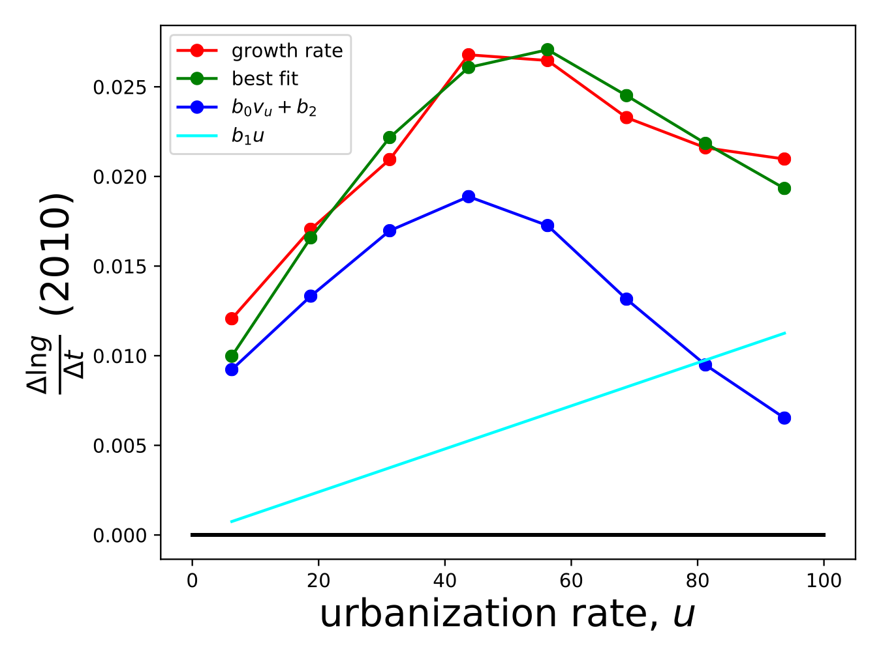
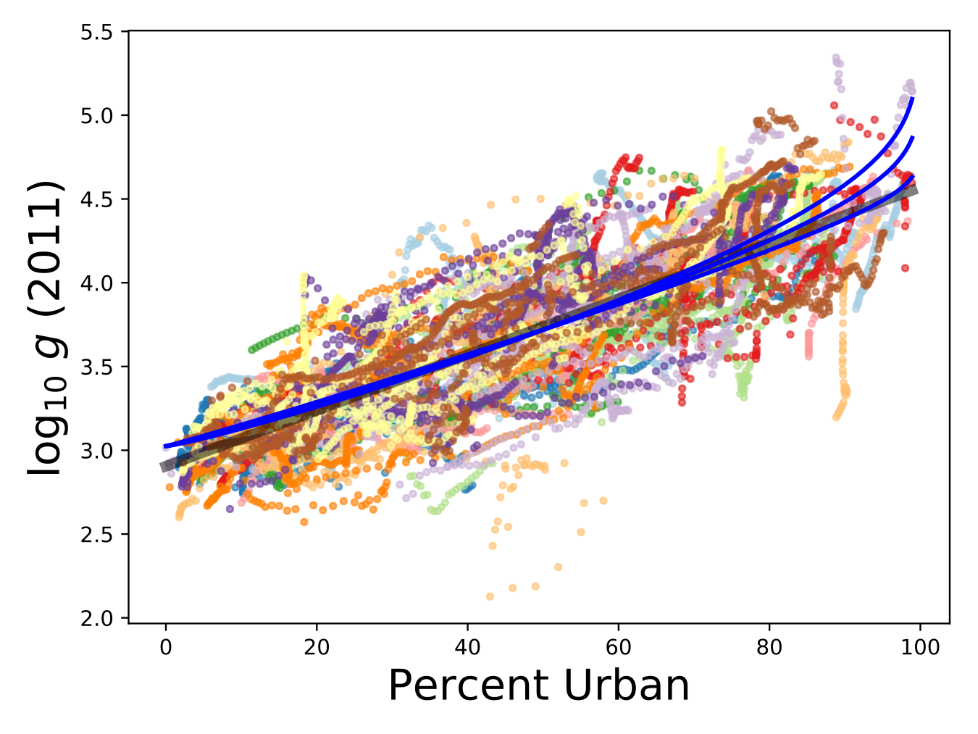
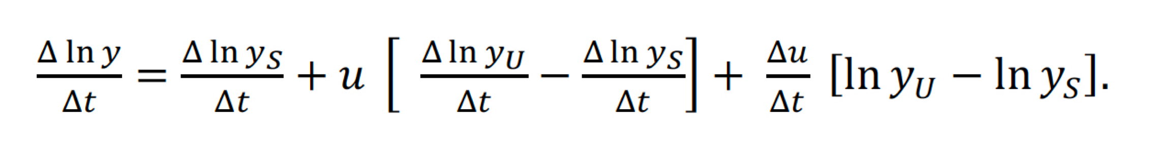
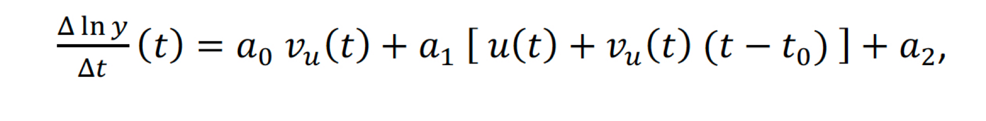
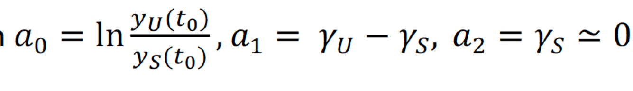
GDP growth rate per year
A.
B.
$$a_{0}v_{u}+a_{2}$$
$$a_{1}u$$
y
y
Percent Urban
urbanization speed boost
$$\frac{Δu}{Δt}=v_{u}$$
Most of the Effect is due to fast migration from rural environments to larger cities
There is a few percent GDP/capita speed up in annual growth rate around 50% urbanized
Notes:
We can use these expressions to actually fit the trajectories, shown here. The model predicts that sorting dominates the middle part of the curves and we can obtain a linear relation, but at both low and very high urbanization the lines must deviate, because there can be endogenous growth (without additional urbanization), as we know in highly urbanized nations: it is just (much) slower. The fastest rates of GDP growth/capita, as a consequence, are obtained around 50% urbanization rate.

Slide 12
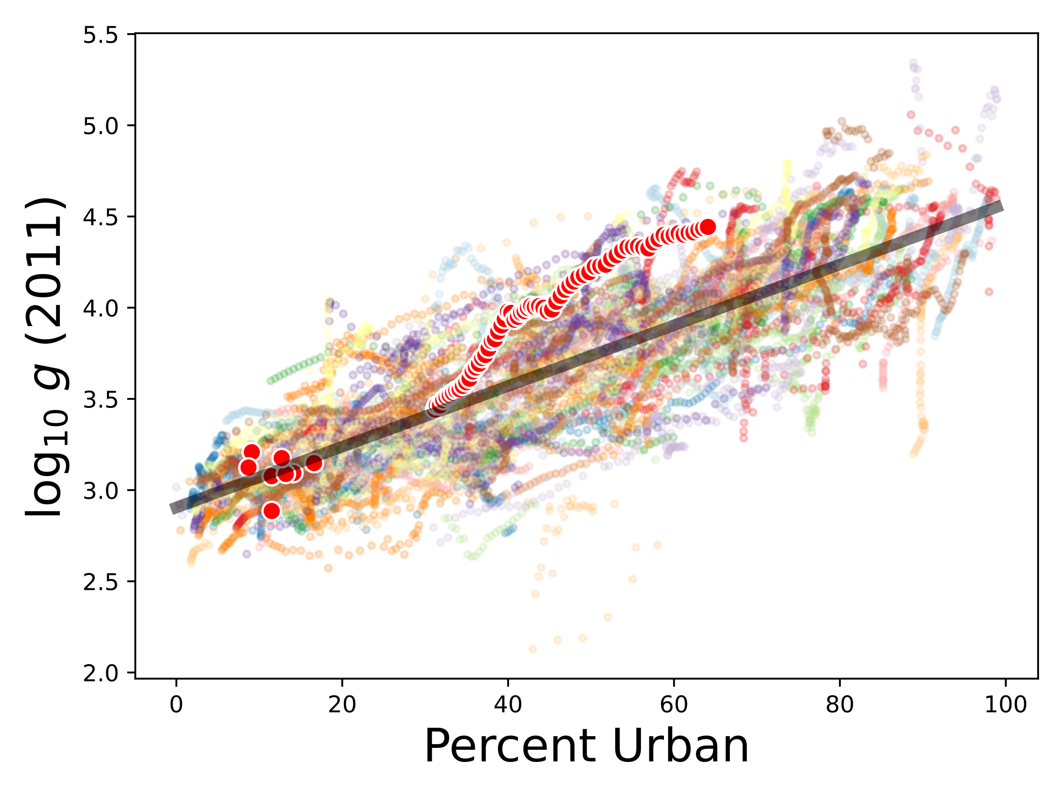
The general connection between urbanization and development:
Portugal
~$50,000/capita/year
My place of birth
Complex
Urban Society
~$300/capita/year
Liberia
Subsistence
Society
Data from
https://ourworldindata.org/grapher/urbanization-vs-gdp
On average, every 1% rise in urbanization leads to a ~4% increase in real GDP/capita!
Notes:
This can also be used to see how well a nation is doing with its urbanization. Here is an example for Portugal, with some context. You can see that its growth relative to urbanization rate is much higher than the average (black line) but that it is still not very rich, in part because it is not very urbanized.

Slide 13
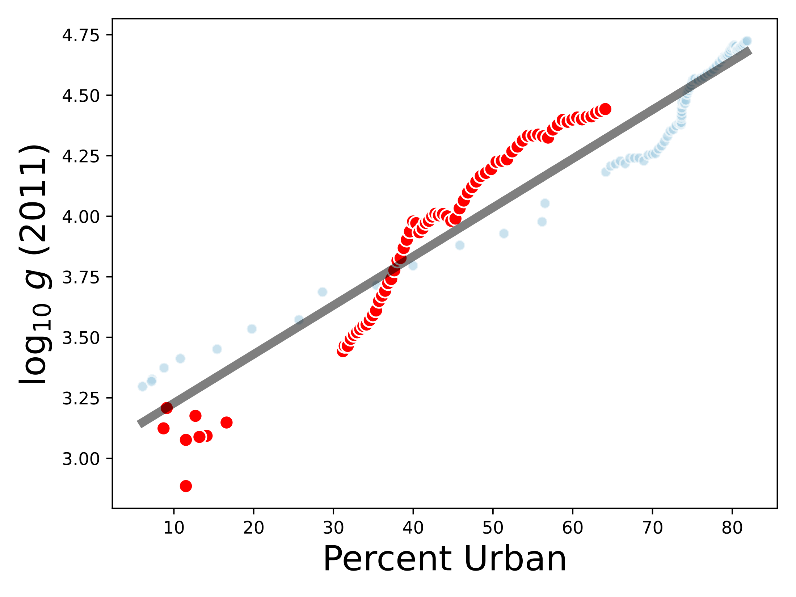
2020: 66% urban, $34K/capita/year
1994
Convergence to EU mean
Germany/Sweden
Portugal
1974
transition to democracy
United States
1700
1920
(50% urban)
Before 20th century
large subsistence economy
1550
Data from
https://ourworldindata.org/grapher/urbanization-vs-gdp
Portugal: every 1% rise in urbanization leads to a ~4.6% increase in real GDP/capita!
What can we do with 20% of urbanization still to go?
Notes:
Here is a direct comparison to the US. Portugal urbanized later but it is doing better for the same levels of urbanization.

Slide 14
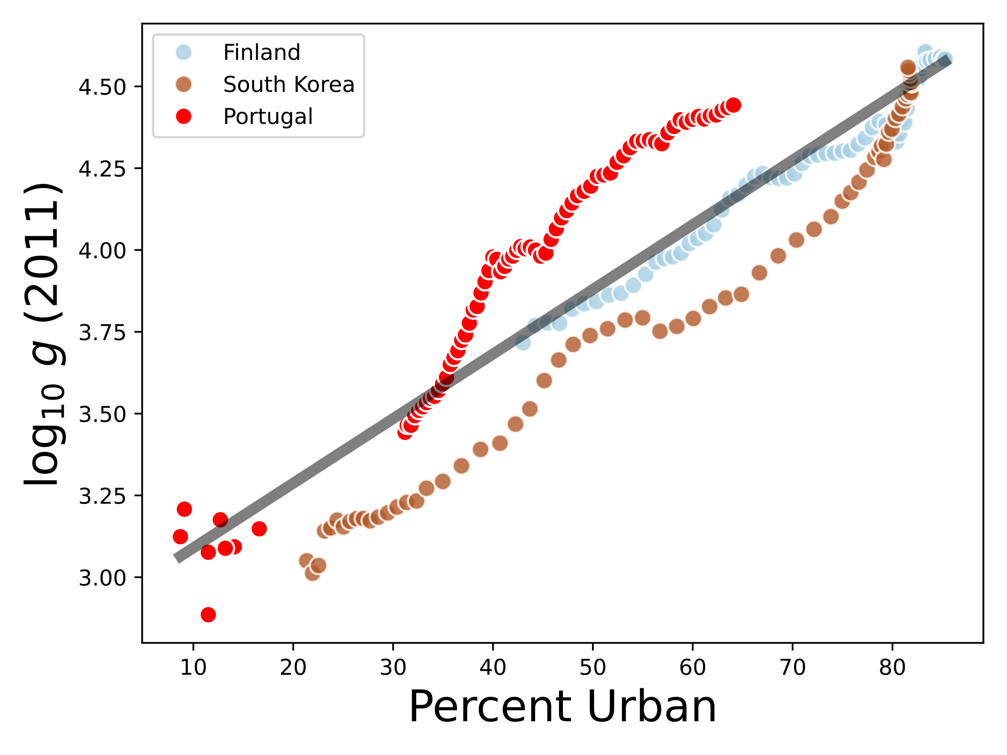
Two other successful “fast urbanizers”
opportunity?
Similar end result
good!
Data from
https://ourworldindata.org/grapher/urbanization-vs-gdp
Notes:
And here is a comparison to two economic “miracle nations”: South Korea and Finland. Portugal is doing better for the same levels of urbanization too, but is much less urbanized. Note how those two nations did not achieve their high levels of wealth without correspondingly high levels of urbanization, and how urbanization in South Korea lagged in terms of income until recently.

Slide 15
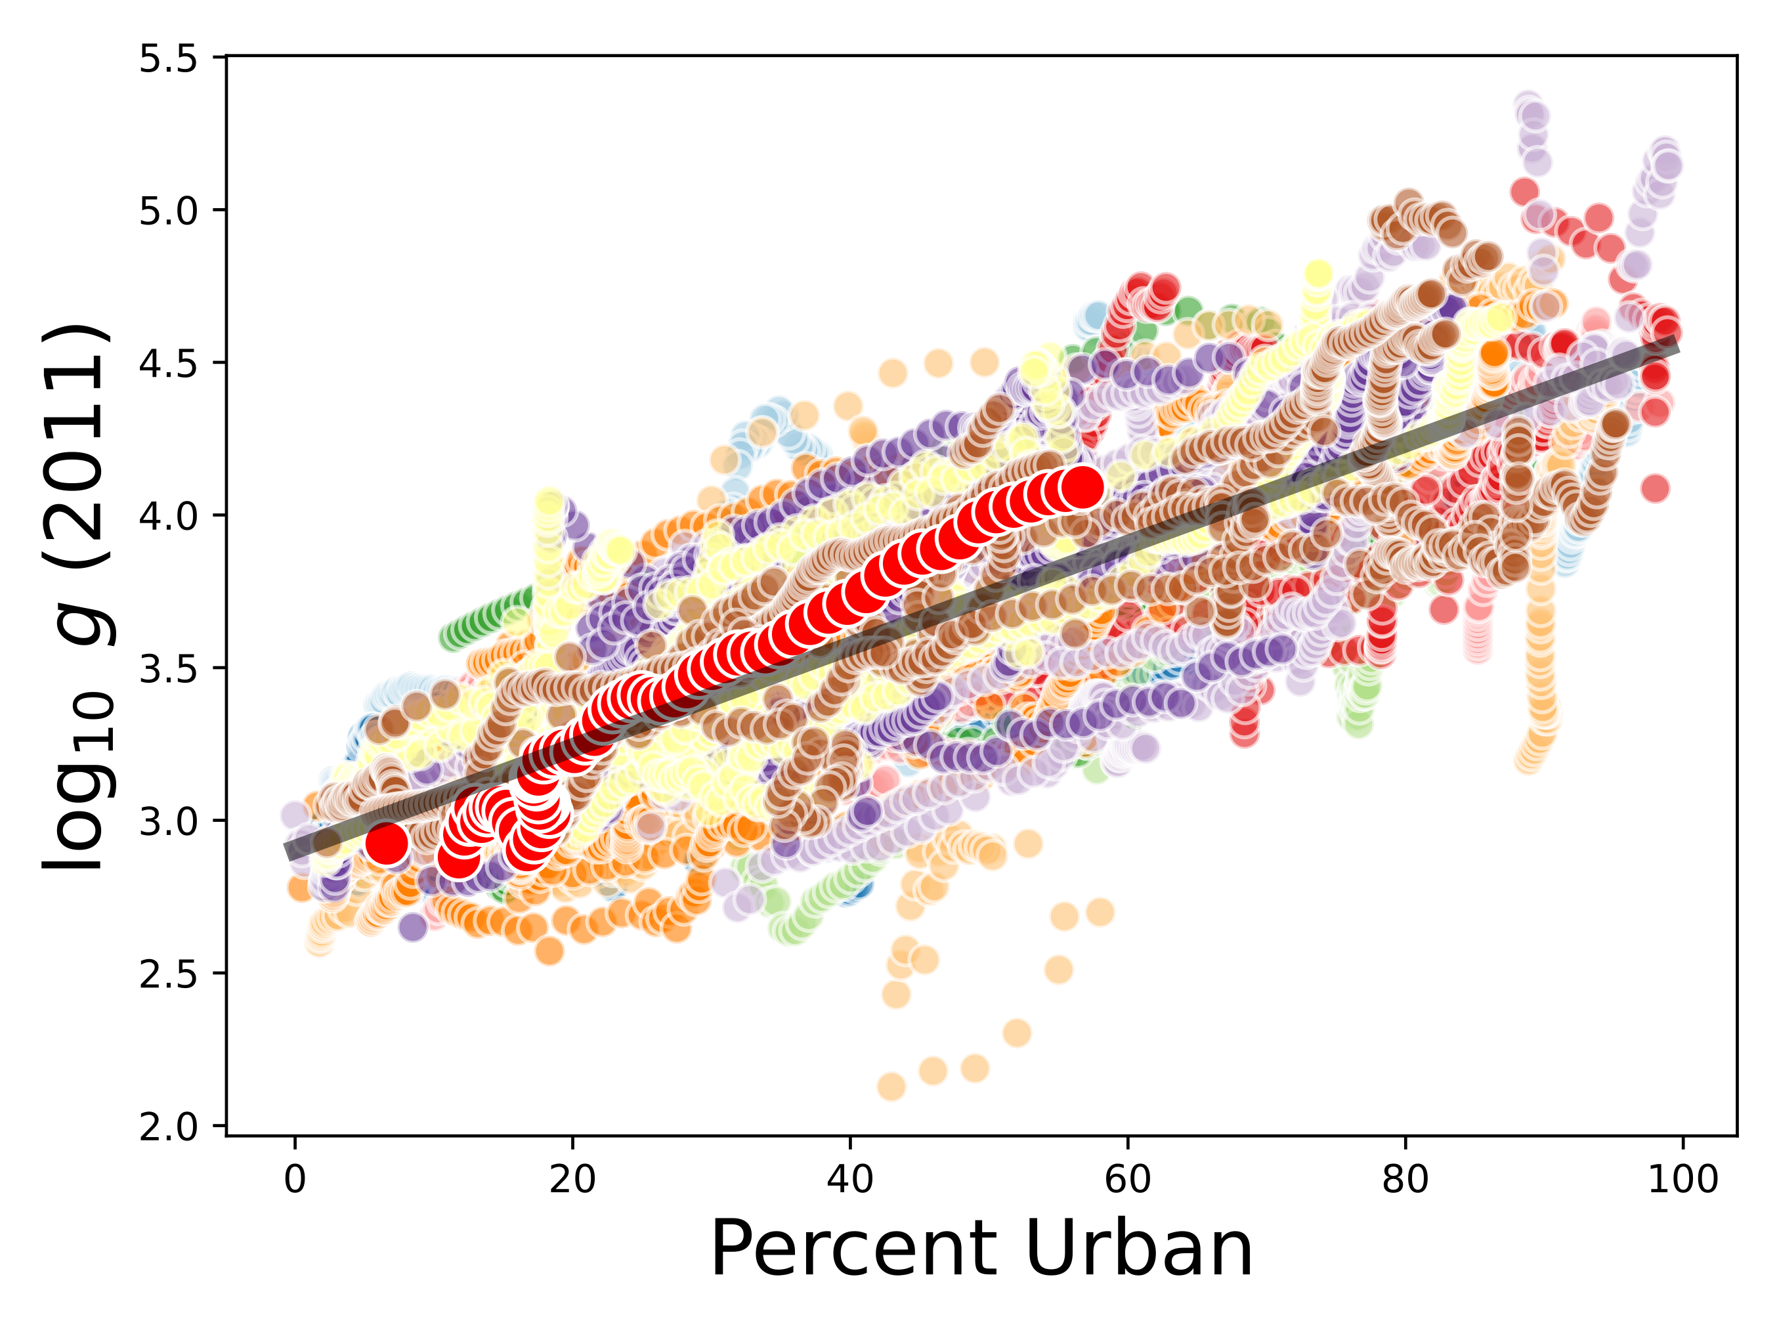
China
6.2% increase in real GDPpc with each 1% urbanization
Notes:
I made a similar argument for PR China. Again, doing well with its levels of urbanization relative to the mean, but not very urbanized yet…

Slide 16
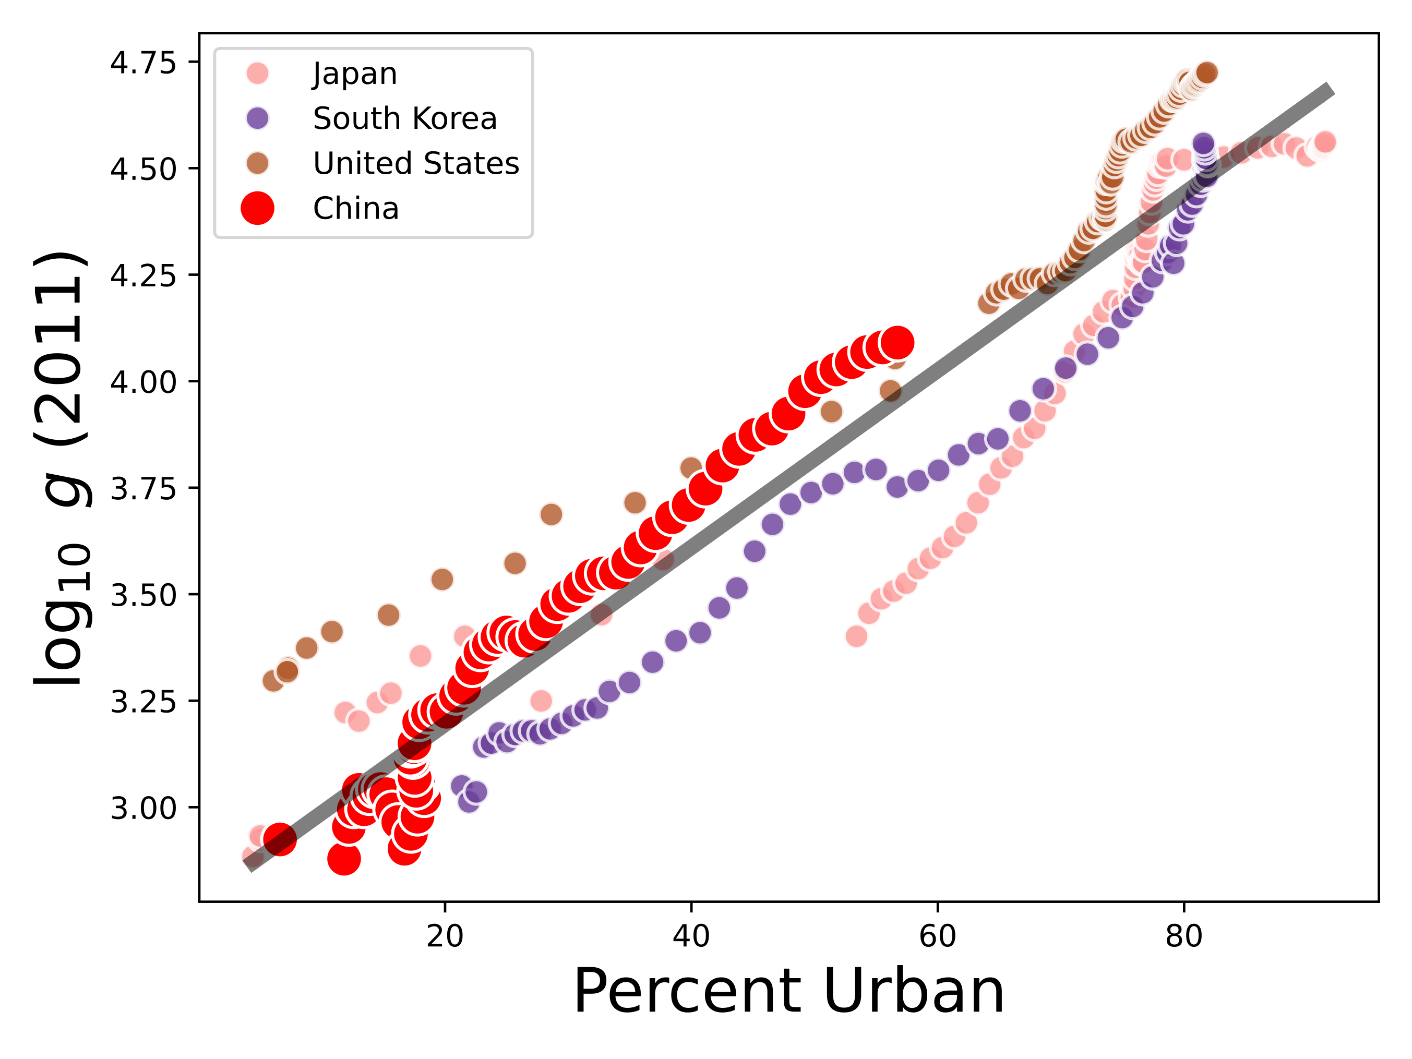
China has done better than others
What will China do with its next 20% of urbanization?
Notes:
Here is a comparison to a few relevant nations. The question, from this perspective, is how well will China do with its next 20% of urbanization? This is indicated by the hypothetical arrows. Note how this reframes the problem of national development from (more abstract) national accounts to the quality and extent of urbanization in each nation, and can in principle be studied more locally.

Slide 17
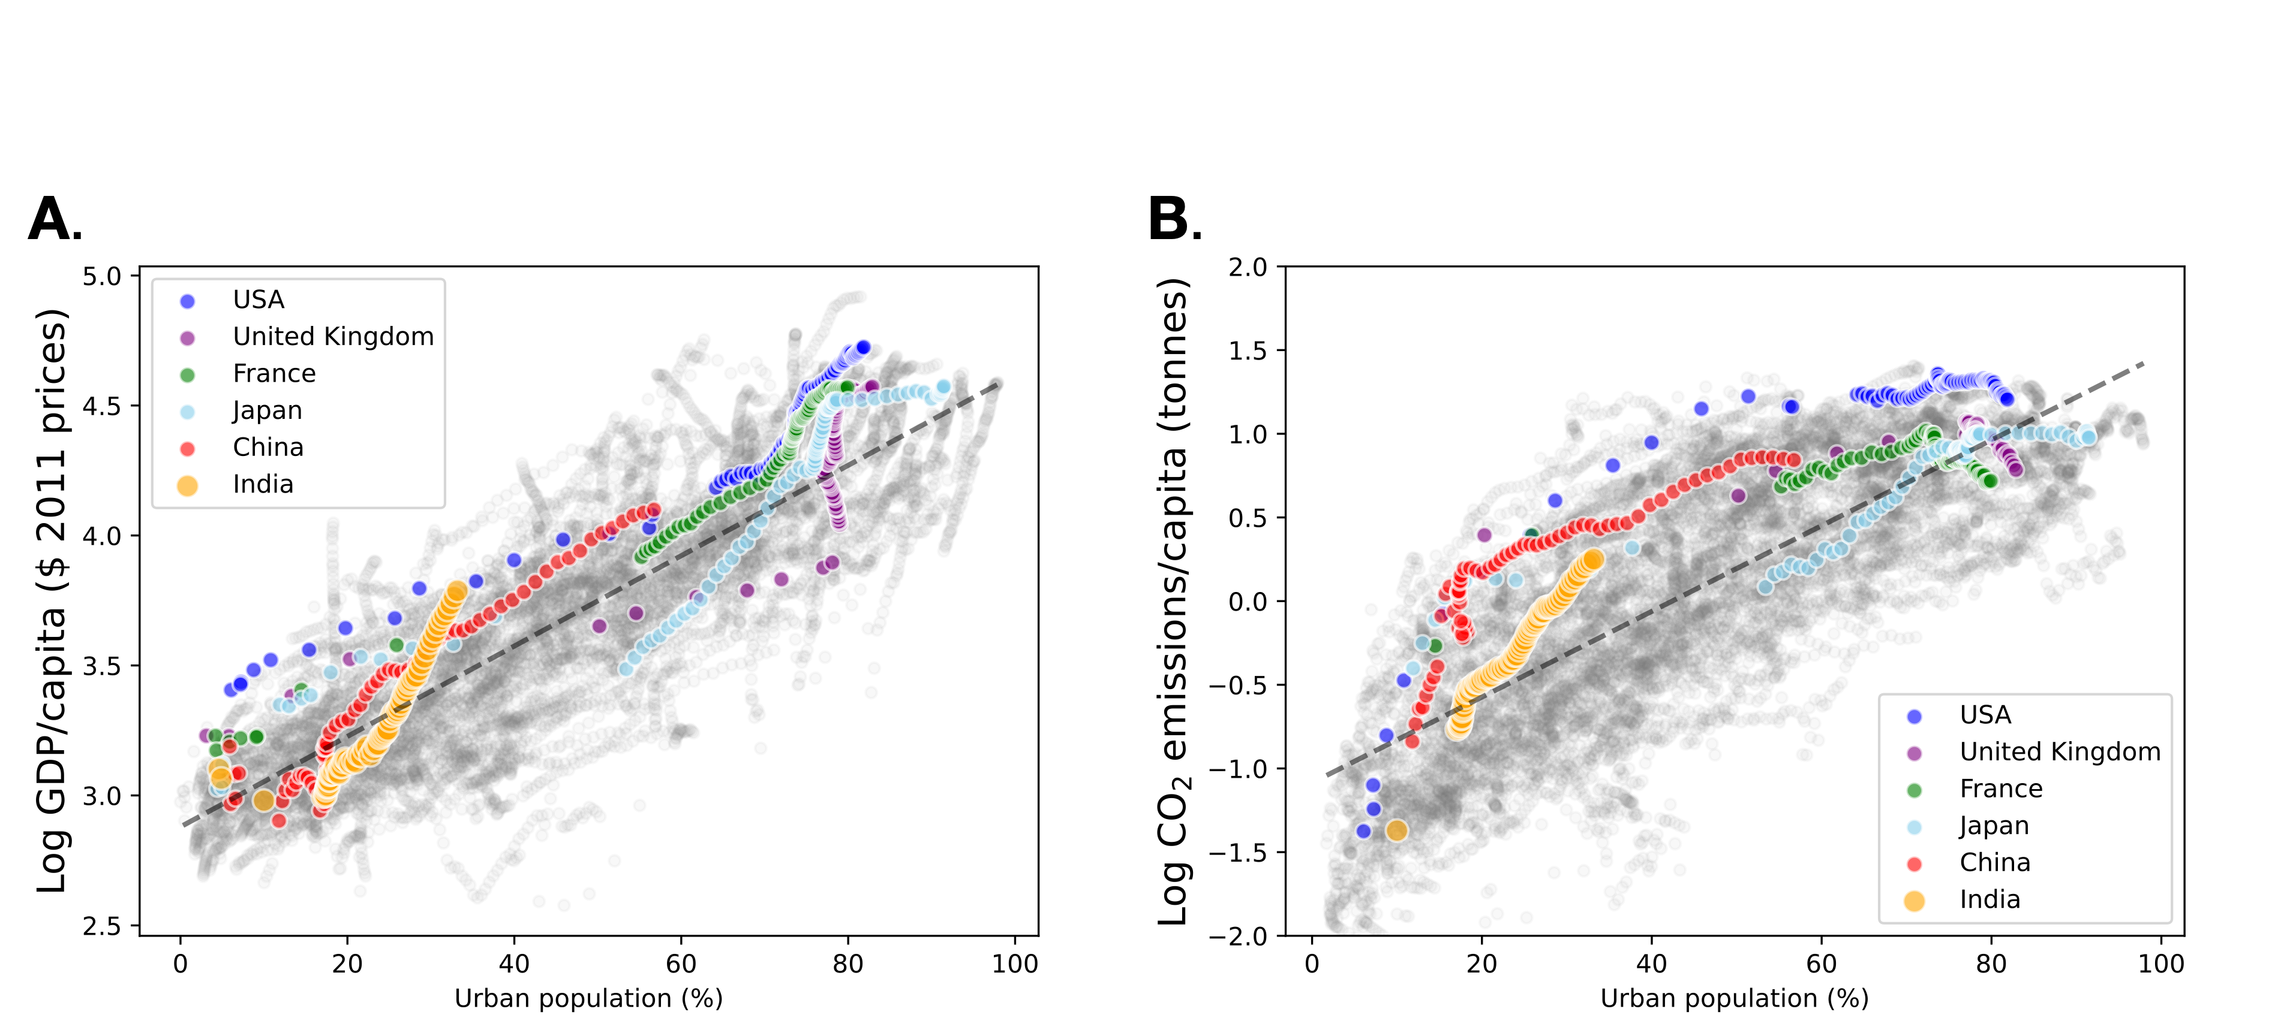
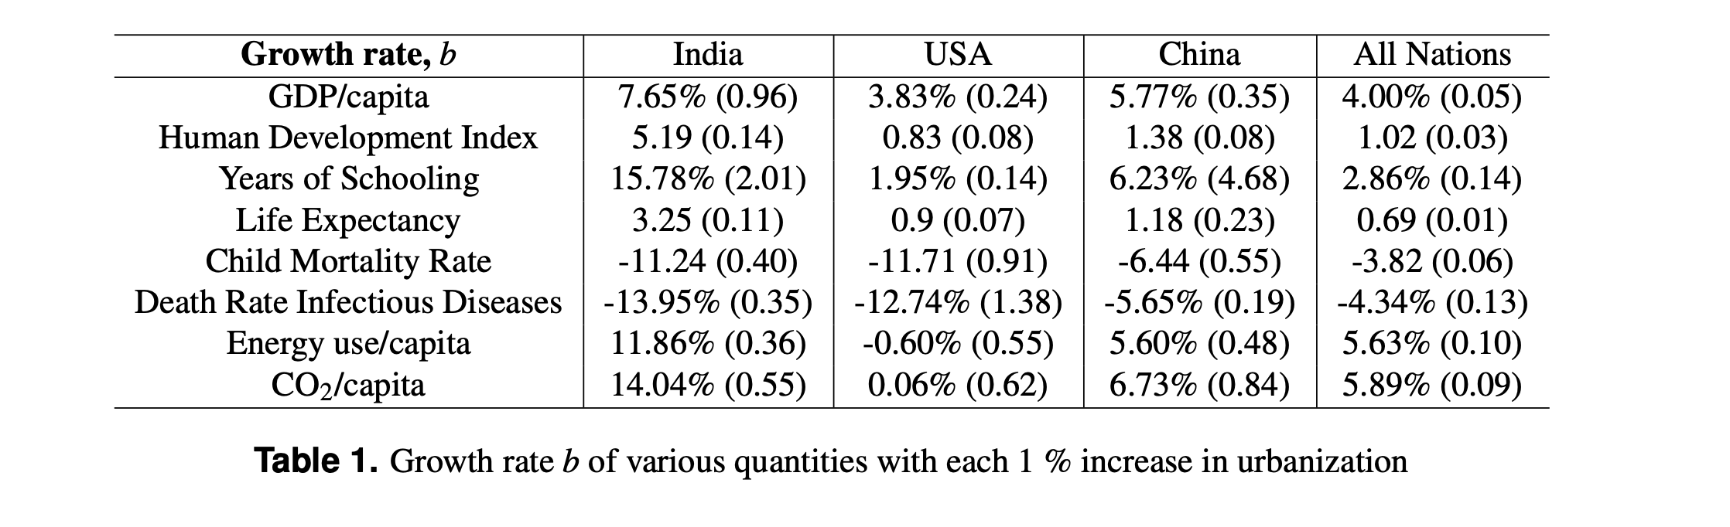
How about India?
Is its urbanization rate underestimated?
https://arxiv.org/pdf/2410.04737

Slide 18
Urbanization begets its impact on economic growth per capita by
taking people from
low GDP situations (rural subsistence) to high GDP situations (large cities)
(structural change)
endogenous economic growth (at the “frontier”) is slower
Notes:
Ok - so the sorting effect of cities, taking people from low income to higher income environments leads to aggregate fast economic growth. This does not mean that people live better, what we did was just math, though I think it is interesting.

Slide 19
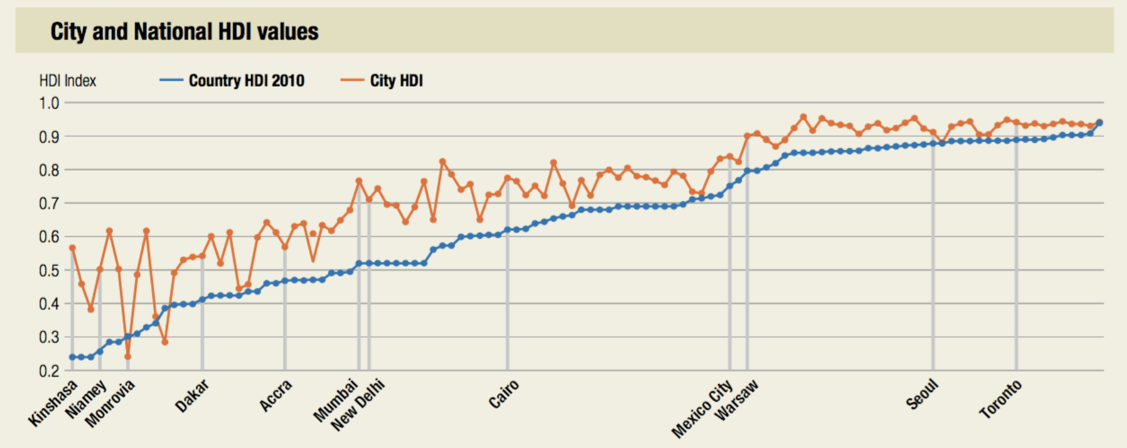
Broad Human Development is a Feature of Larger Cities !
Country and City Human Development Index (HDI) values
HDI value
Country HDI 2010
City HDI
credit: UNDP Human Development Report 2013
(Led by Pedro Conceição, Director and lead author)
Notes:
And here is another picture, from UN-Habitat, showing that the human development index is higher in almost every large city compared to their nation. This measures the product of real income, education and life expectancy.

Slide 20
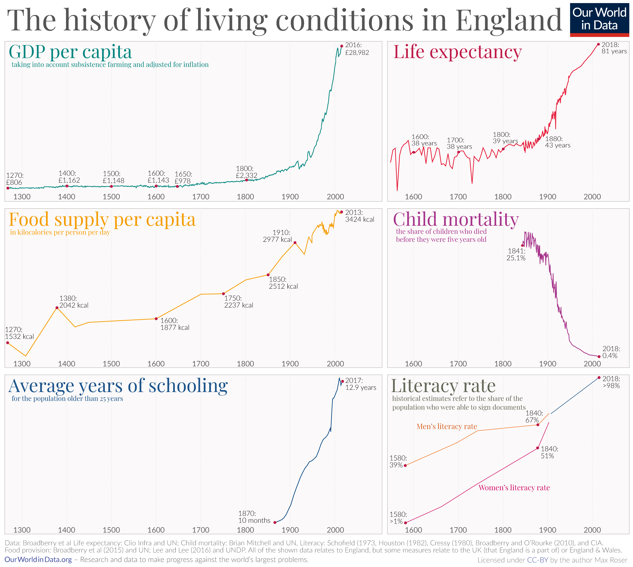
https://ourworldindata.org/breaking-the-malthusian-trap
50% urban
50% urban
Notes:
But I want to emphasize that GDP/capita is just one of many measures that are connected to urbanization. Here is what happened in Britain (which lagged, as we saw) after it urbanized in terms of a bunch of other indicators of development. The vertical lines show 50% urbanization rate (more or less), which as you can see was also the time they started creating some of this data …

